Slide 1
Online Food Ordering System

Slide 2
Frontend Team
Rohith Saravanan
Tatipamula Ramya
Mahesh Basa
Durga Maddimsetti
Dalavai Hruday
Pritam M

Slide 3
Introduction
Our Online Food Ordering System is a comprehensive platform designed to streamline the food ordering process for customers, restaurants, and delivery personnel.
The frontend plays a critical role in delivering a seamless and intuitive user experience,
Ensuring that customers can browse menus, place orders, and track deliveries effortlessly.
Restaurants can efficiently manage their menus, process orders, and monitor customer feedback.
Delivery personnel can track assigned orders and update statuses on the go.

Slide 4
Overview of the Work
The Online Food Ordering System frontend ensures a user-friendly interface for customers, restaurants, and delivery personnel, featuring tailored login, registration, and homepage functionalities. It includes a form validation page for data accuracy, customer order tracking, menu management, delivery updates, and a feedback system for a seamless experience.

Slide 5
Key Features
Customer Login & Forgot Password
Customer Registration
Customer Homepage
Restaurant Login & Registration
Restaurant Homepage
Delivery Login & Registration
Delivery Homepage
Feedback Form
Power BI Report

Slide 6
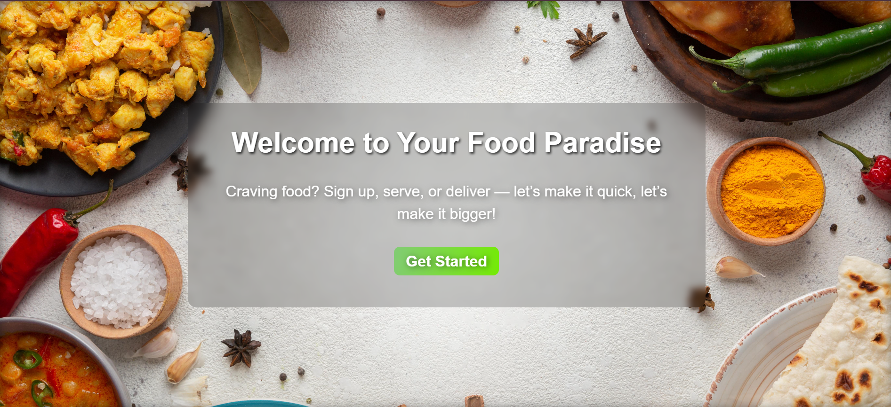
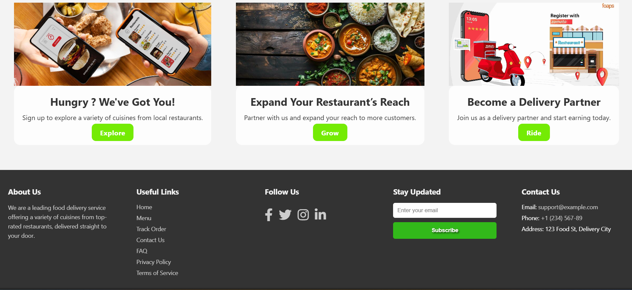
Homepage: The homepage serves as the landing page and navigate to other sections of the application.

Slide 7

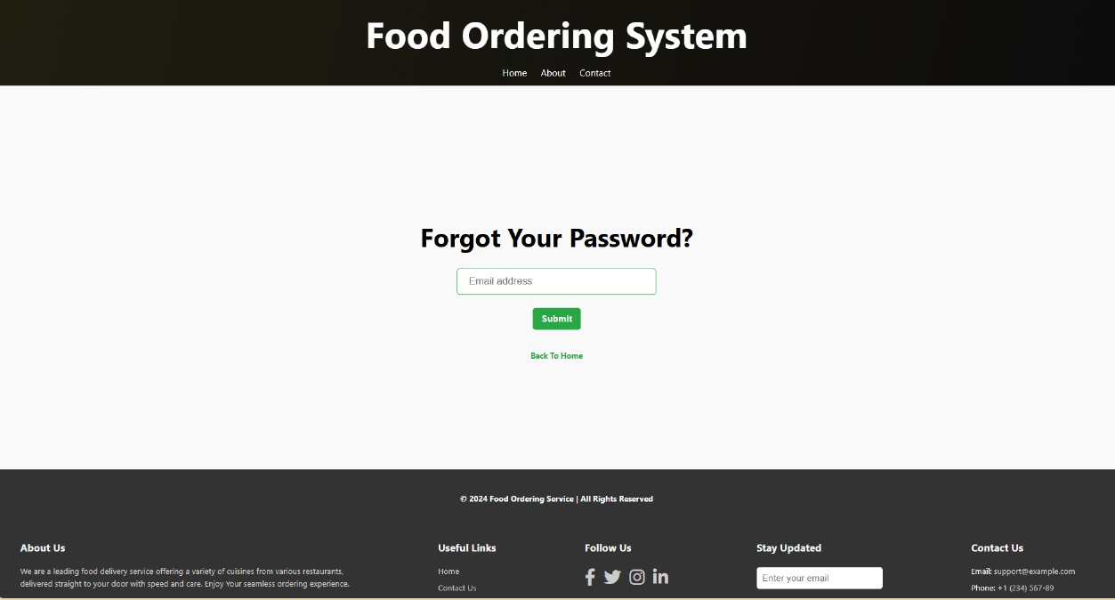
Customer Login & Forgot Password Page: The Customer Login page allows users to securely log in to their accounts, while the Forgot Password page enables users to reset their password.

Slide 8
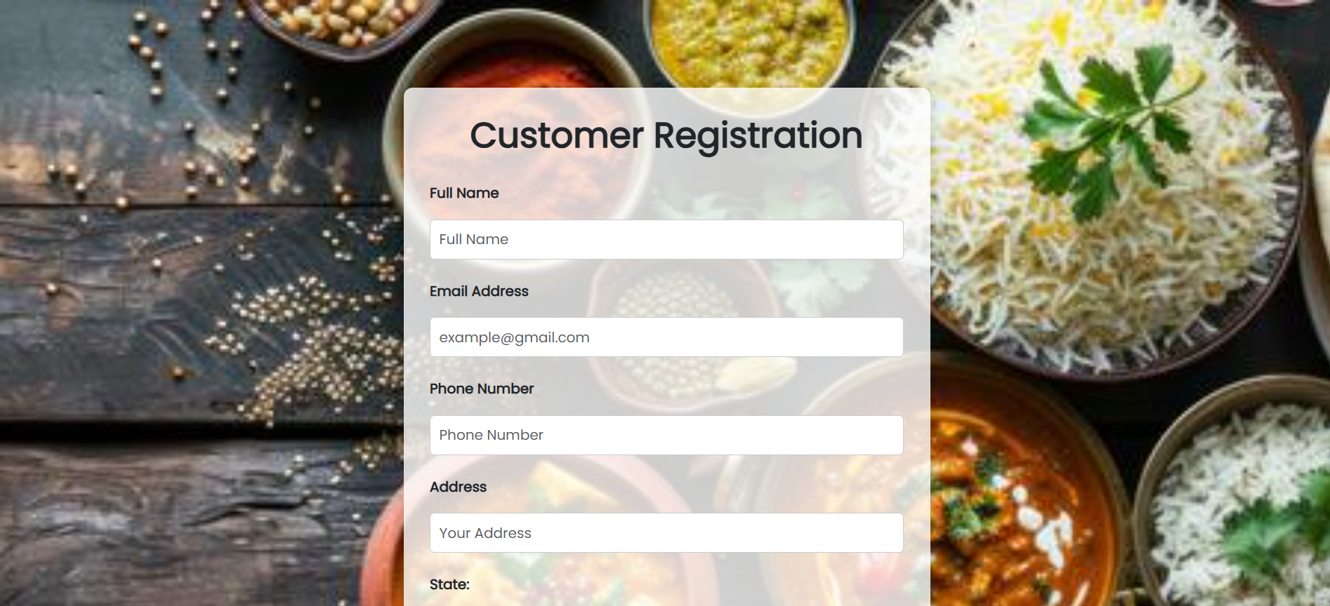
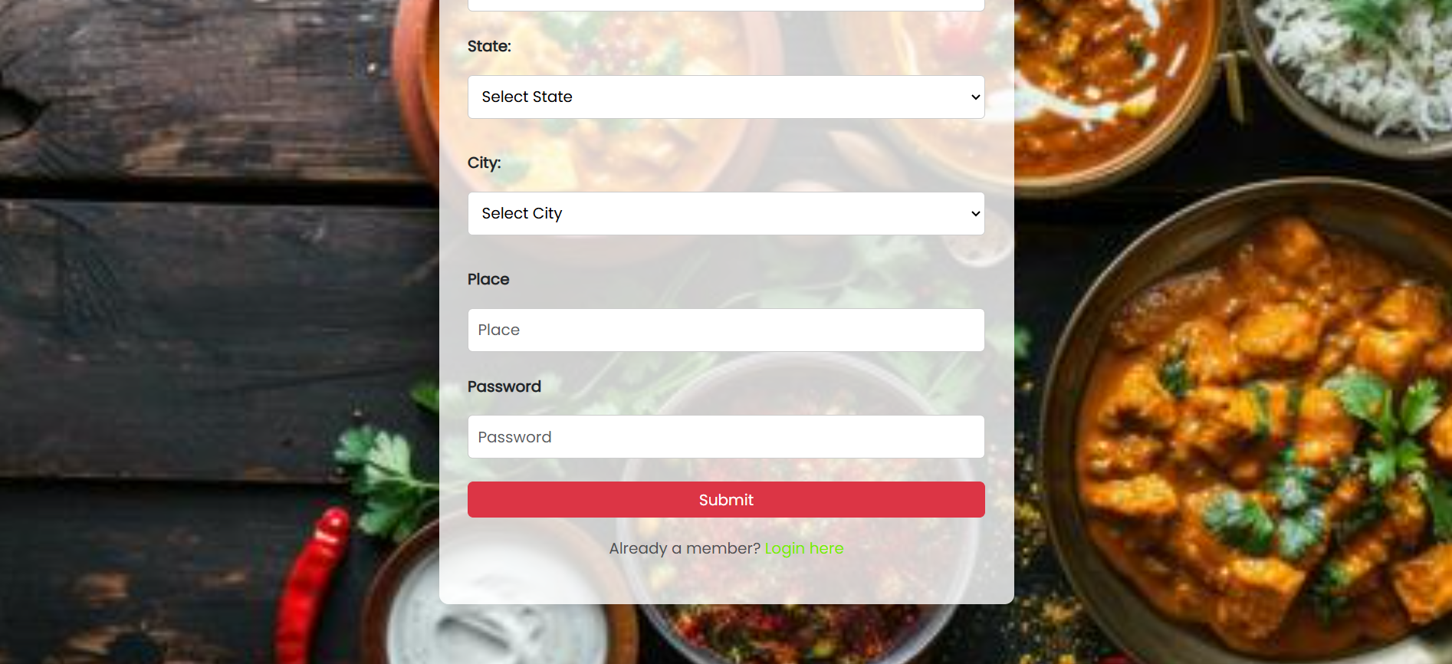
Customer registration Page: The Customer Registration page allows new users to create an account by providing their details and setting up login credentials.

Slide 9
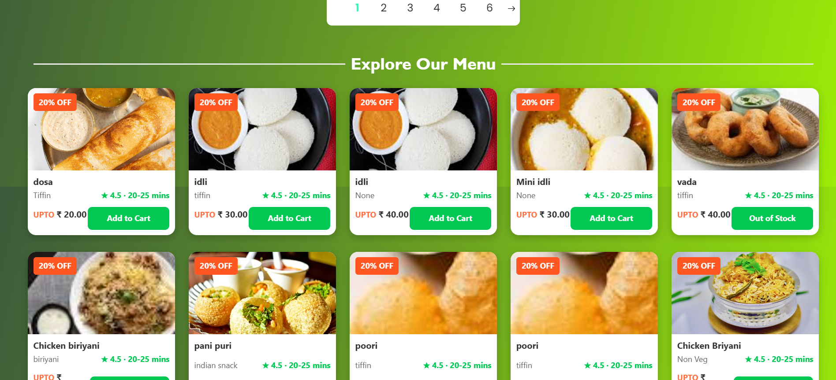
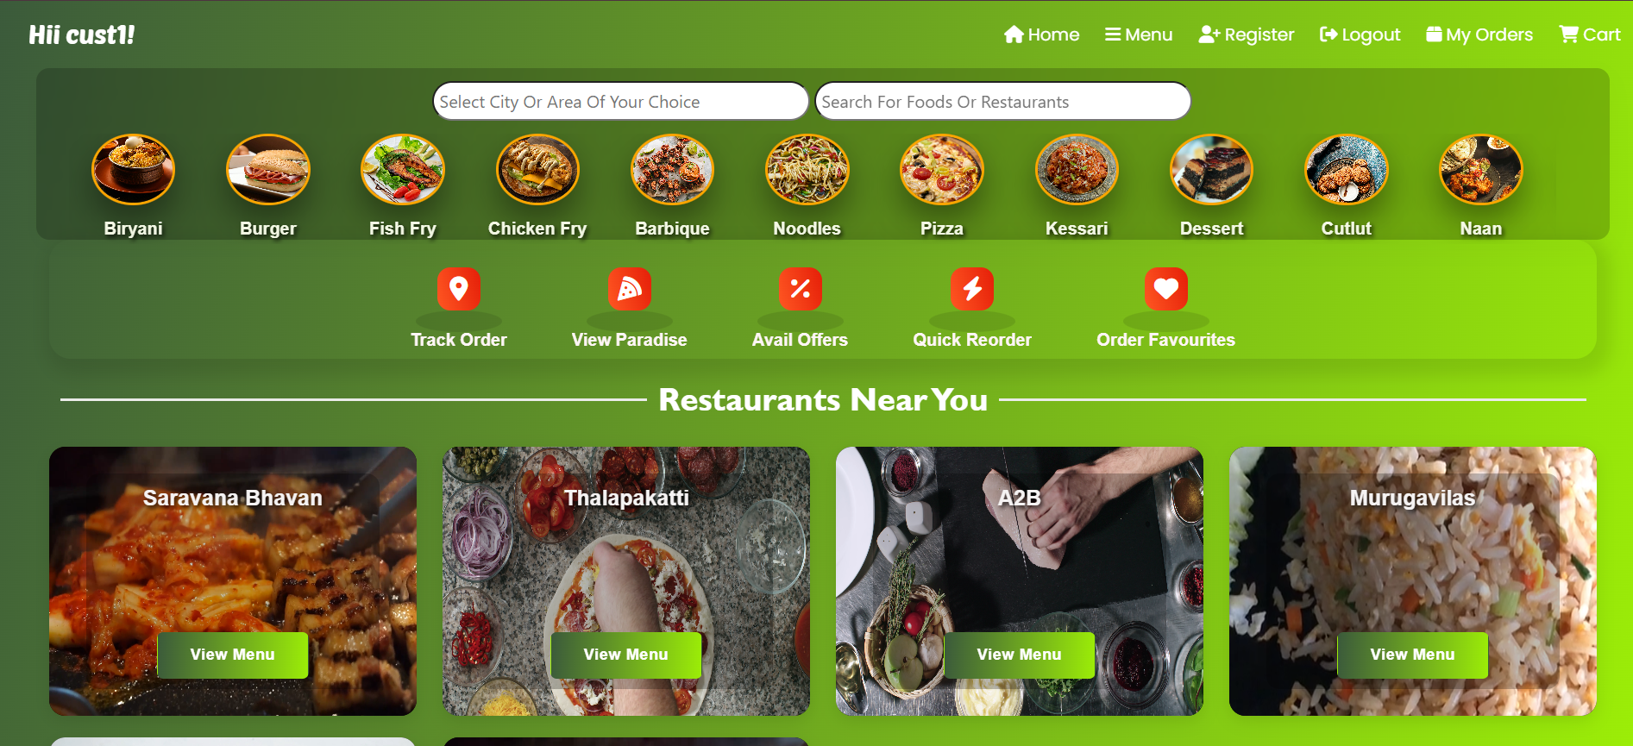
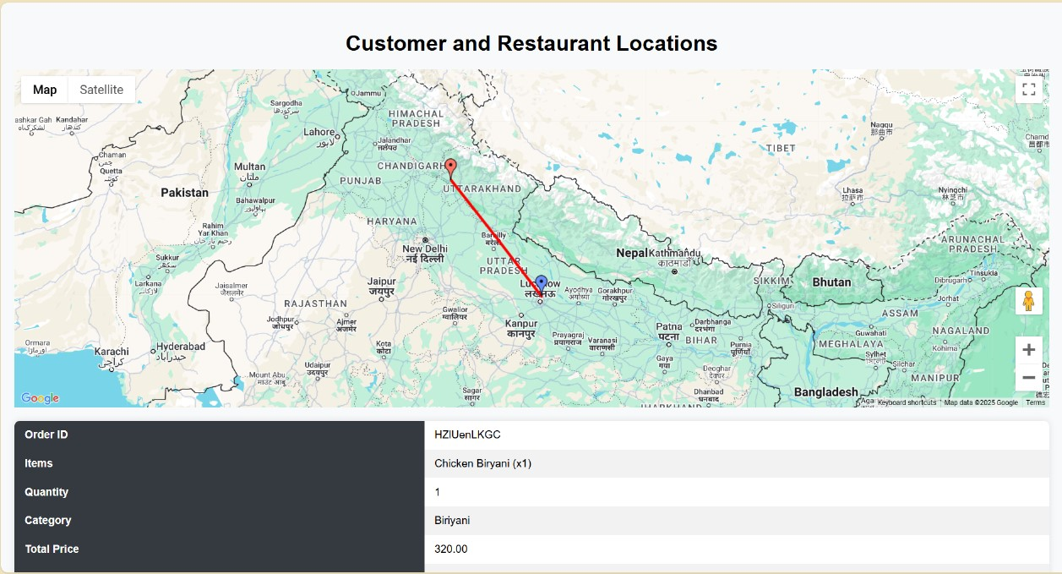
Customer Homepage: The Customer Homepage displays personalized options like browsing menus, viewing orders, placing orders and even tracking their delivery.

Slide 10
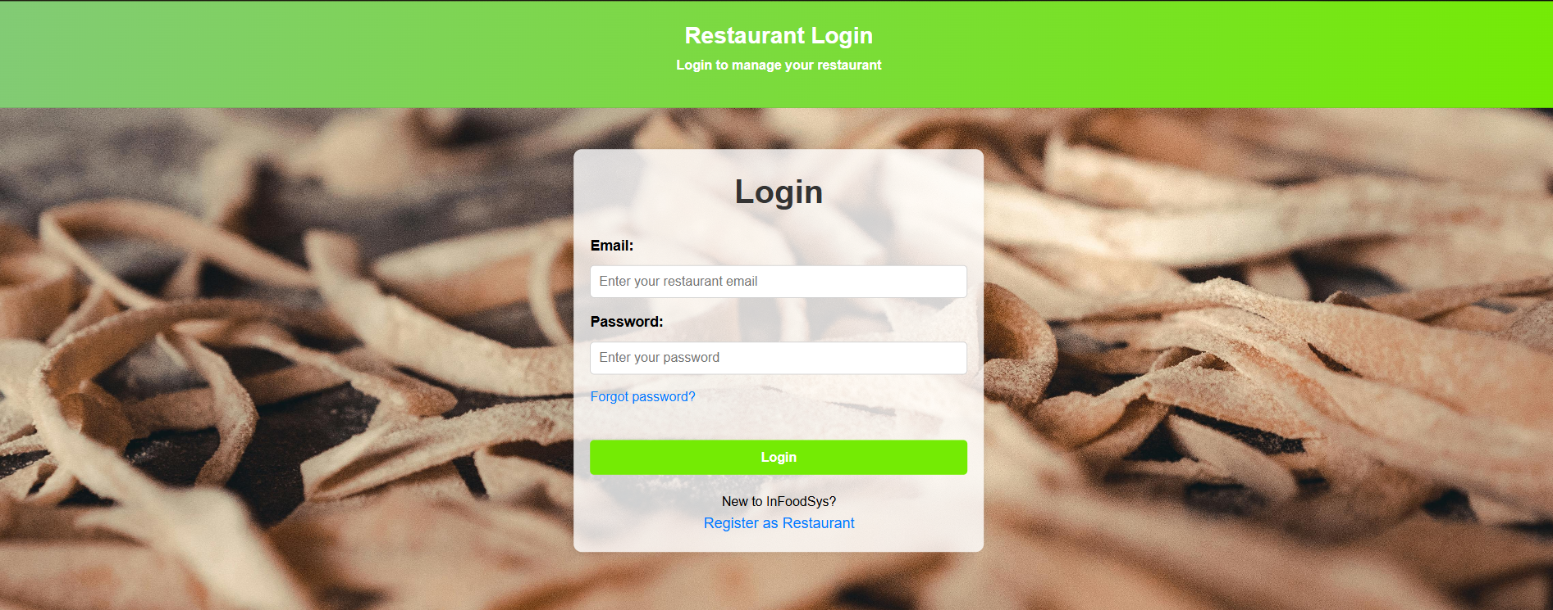
Restaurant Login Page: The Restaurant Login page allows restaurant owners to securely access their accounts and manage their services.

Slide 11
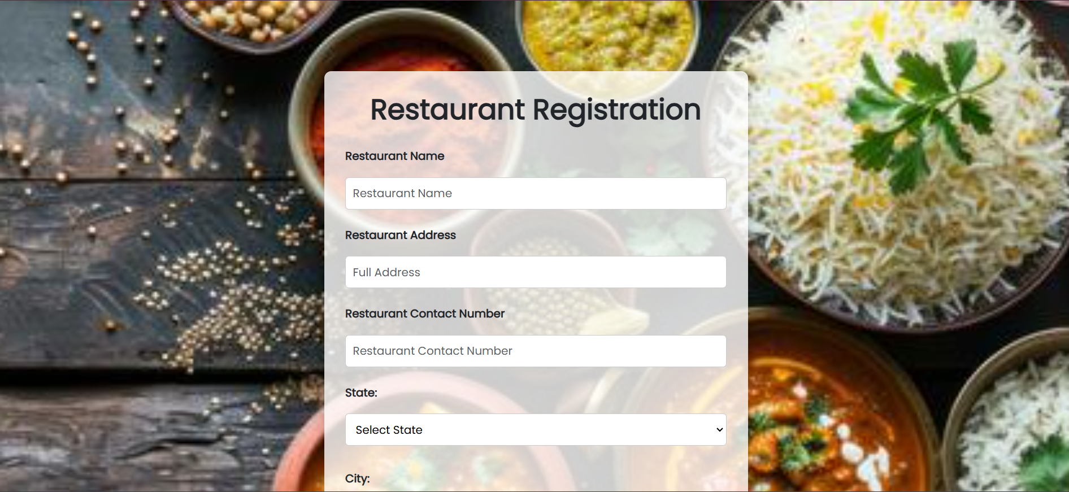
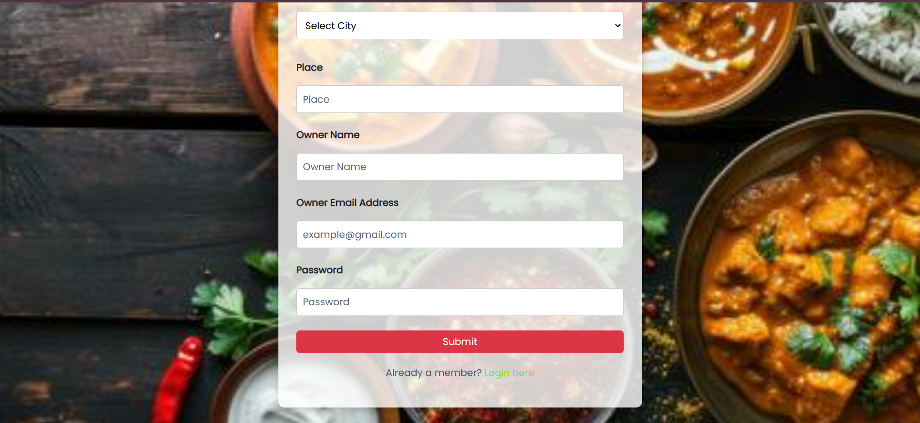
Restaurant Registration Page: The Restaurant Registration page enables restaurants to create an account by providing their details and business information.

Slide 12
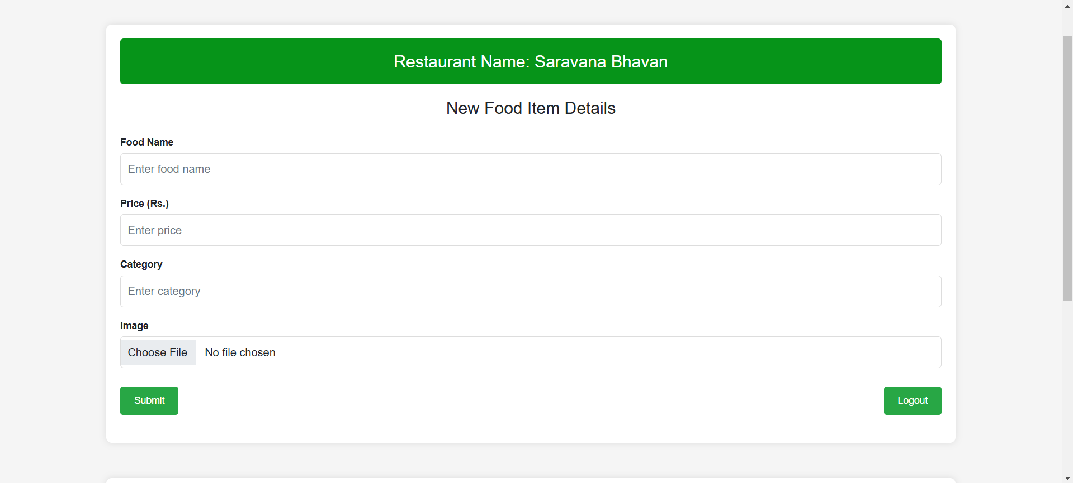
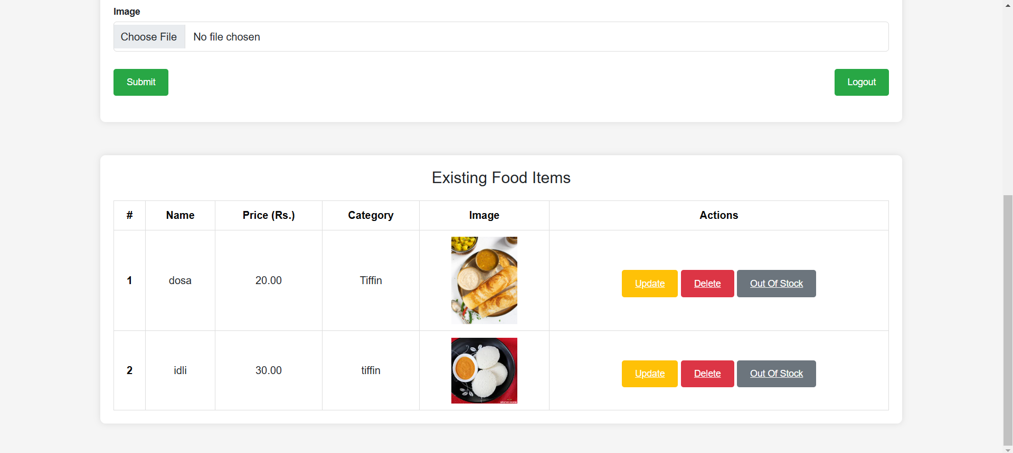
Restaurant Homepage: The Restaurant Homepage allows restaurant owners to manage menus, view orders, and update their profile.

Slide 13

Delivery Login Page: The Delivery Login page allows delivery personnel to securely log in to access and manage their delivery tasks.

Slide 14
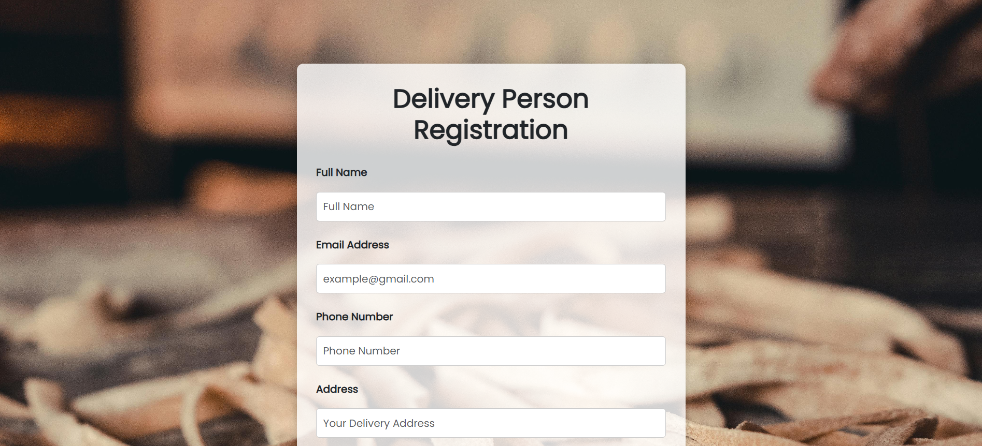
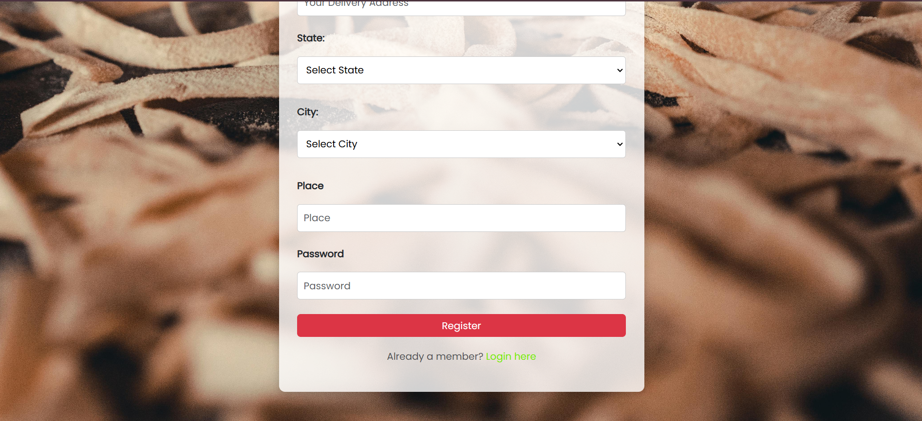
Delivery Registration Page: The Delivery Registration page enables delivery personnel to create an account by providing their personal and contact details.

Slide 15
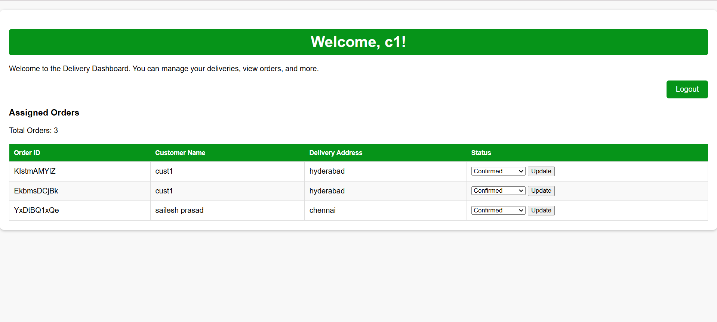
Delivery Homepage: The Delivery Homepage allows delivery personnel to view assigned orders, track deliveries, and update delivery statuses.

Slide 16
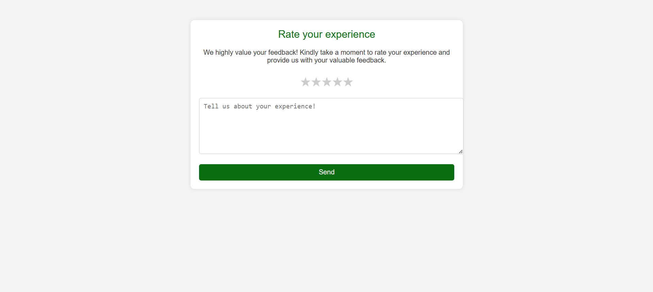
Feedback Form Page: The Feedback Form page allows customers to provide reviews and ratings for their experience with the service or food.

Slide 17
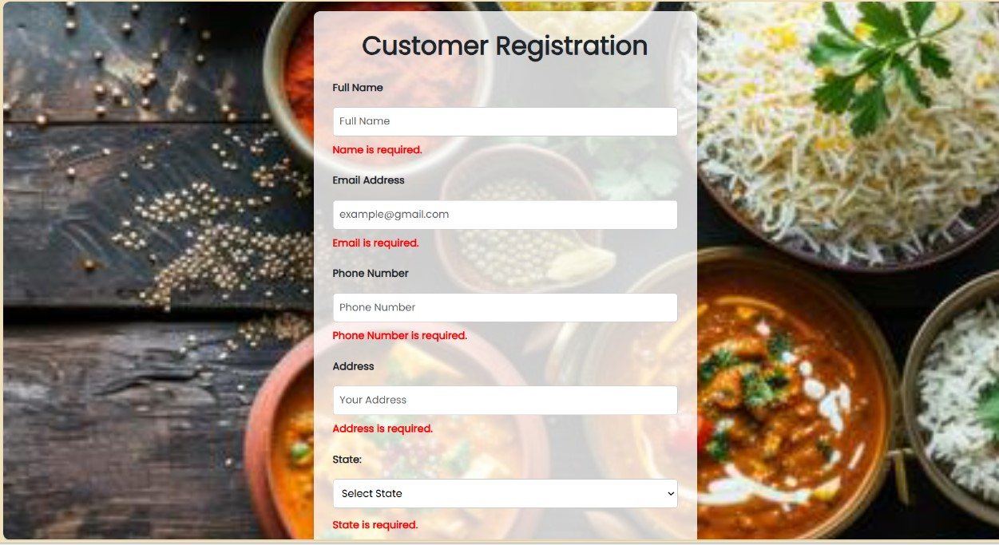
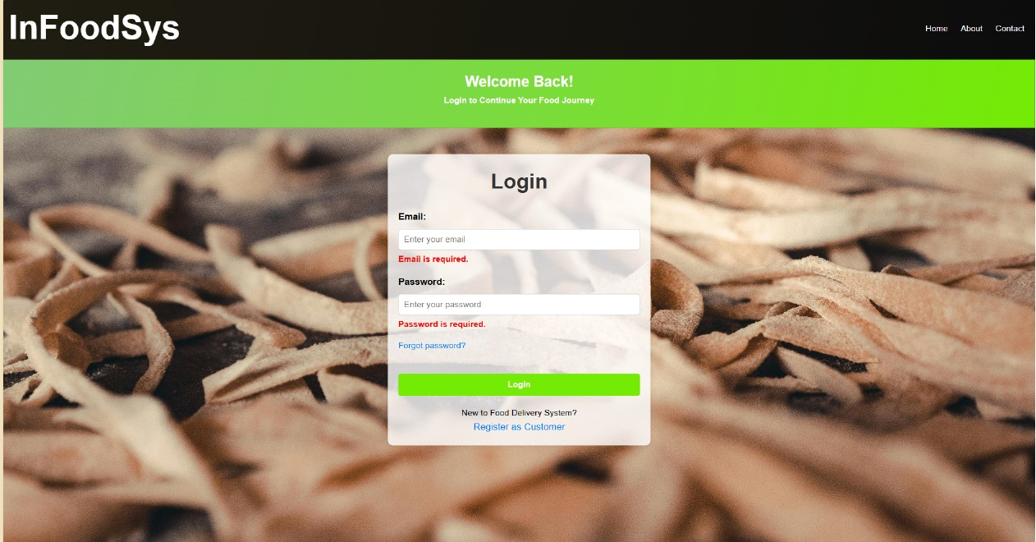
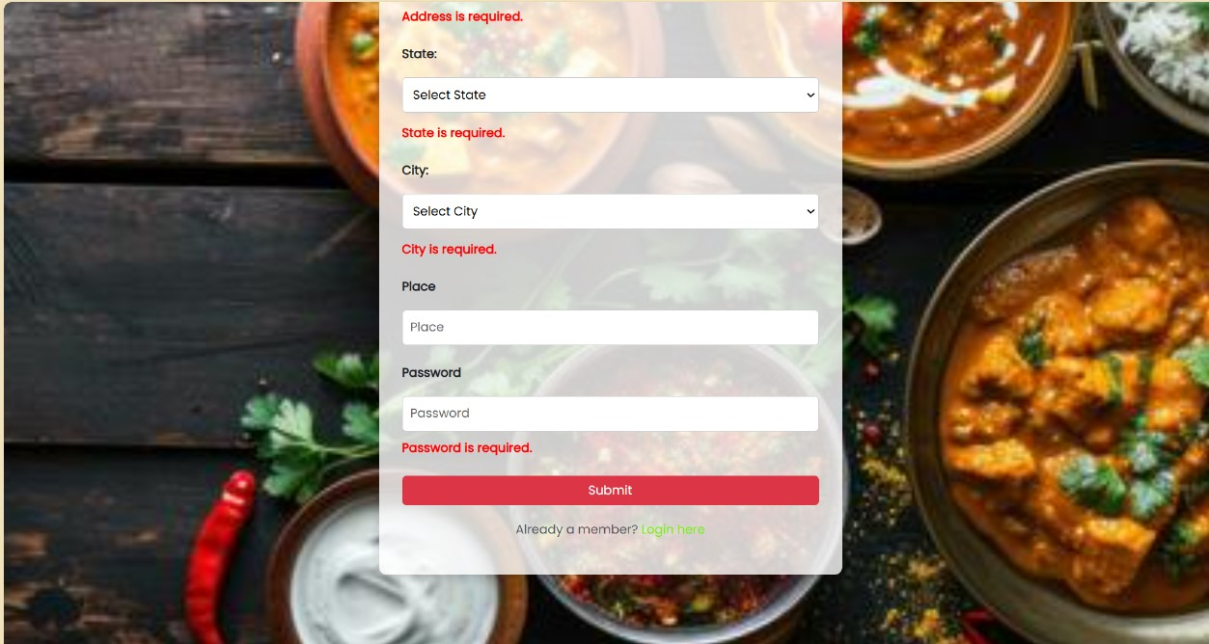
Form Validation: This page ensures all user inputs comply with the required criteria, providing real-time feedback for errors or missing fields in all the modules. It enhances data accuracy, improves user experience, and strengthens application security.

Slide 18
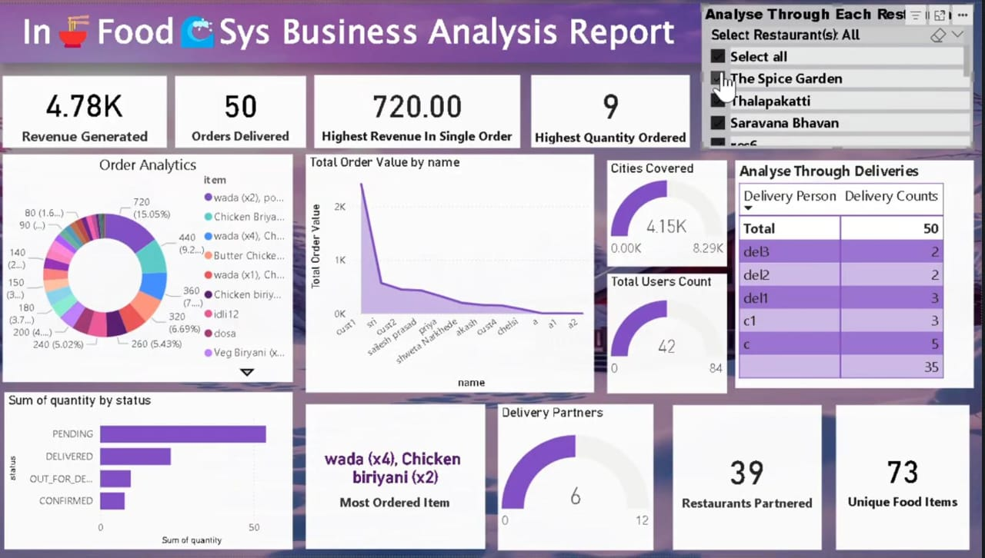
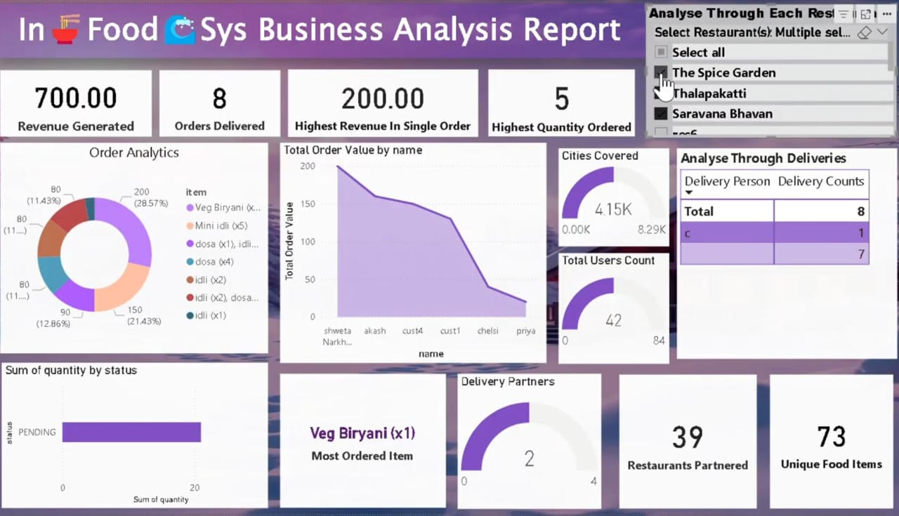
Power BI Report : Report provides highly connected dynamic view of business actions of the application starting from basis measure to highly insightful statics.

Slide 19
Conclusion
The frontend ensures an intuitive & seamless user experience by connecting users to backend operations efficiently.
Features like secure login, dynamic interfaces & personalized dashboards enhance usability.
Provides a modern, responsive & visually appealing design for customers, restaurants & delivery personnel.
Highlights the team’s efforts in creating a scalable and user-friendly platform for online food ordering.
Sets the foundation for future improvements, such as interactive features & enhanced performance optimization.

Slide 20
Thank You

